Slide 1
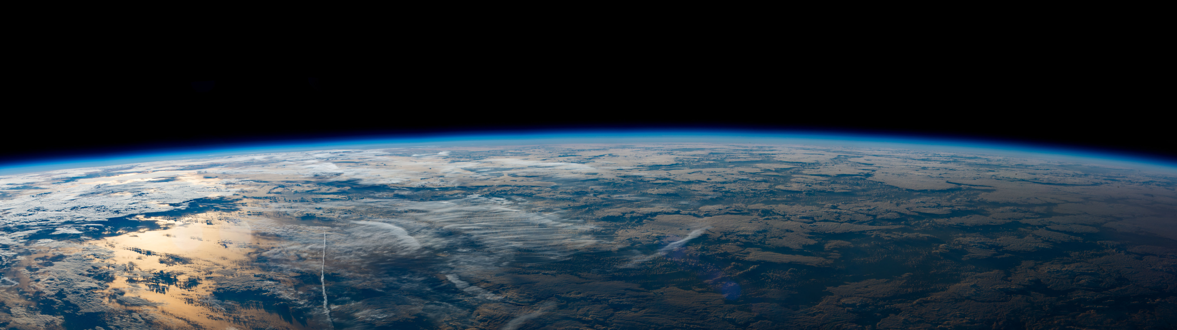
Marine Debris Detection through Satellite data
Lorenzo Magnanelli

Slide 2
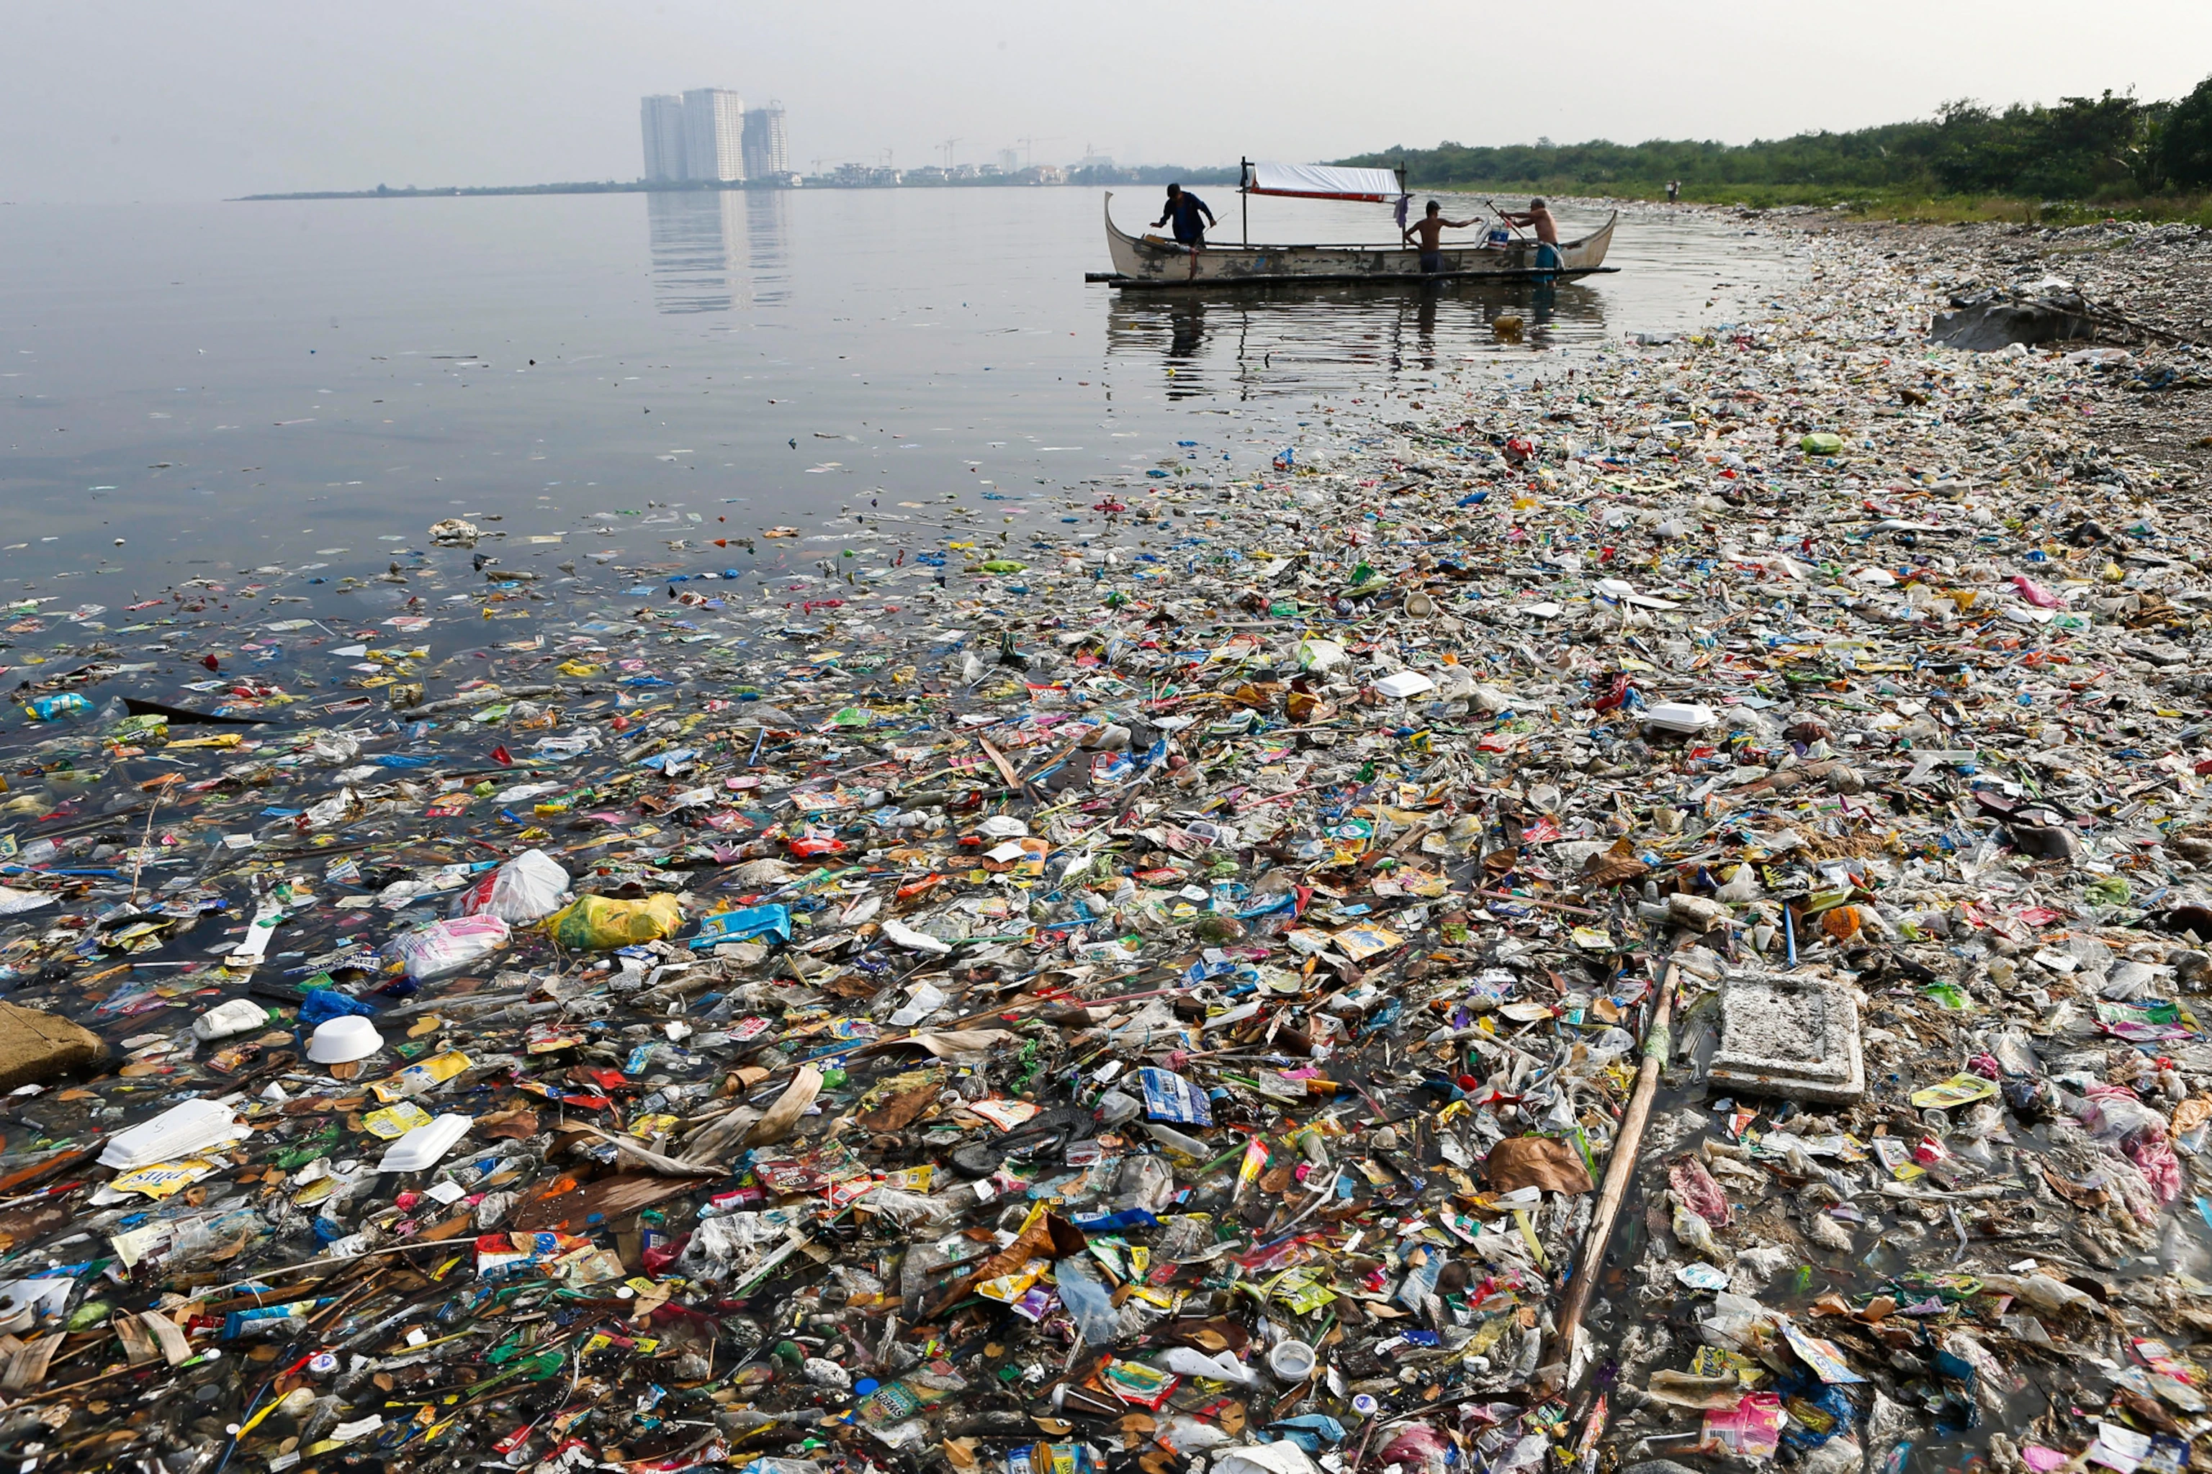
We are in deep water
Marine Debris has got out of hand
Plastic items can take up to 1000 years to decompose
This is a real danger for both humans and animals
Several solutions have been developed to tackle this issue
Satellite remote sensing is one of them

Slide 3
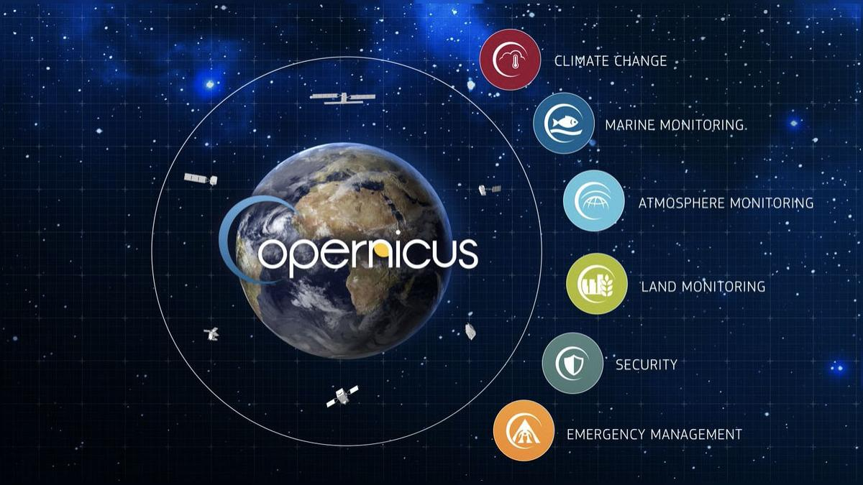


Slide 4
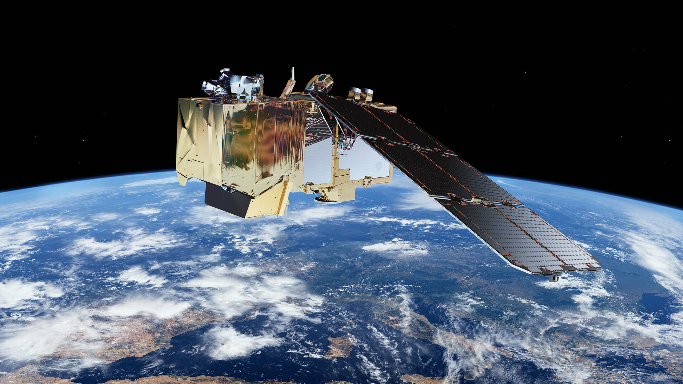
Sentinel-2 mission
Two identical satellites in the same orbit
Sentinel-2A on 23 June 2015
Sentinel-2B on 7 March 2017
High-resolution multispectral imager with 13 bands
5-day revisit time

Slide 5
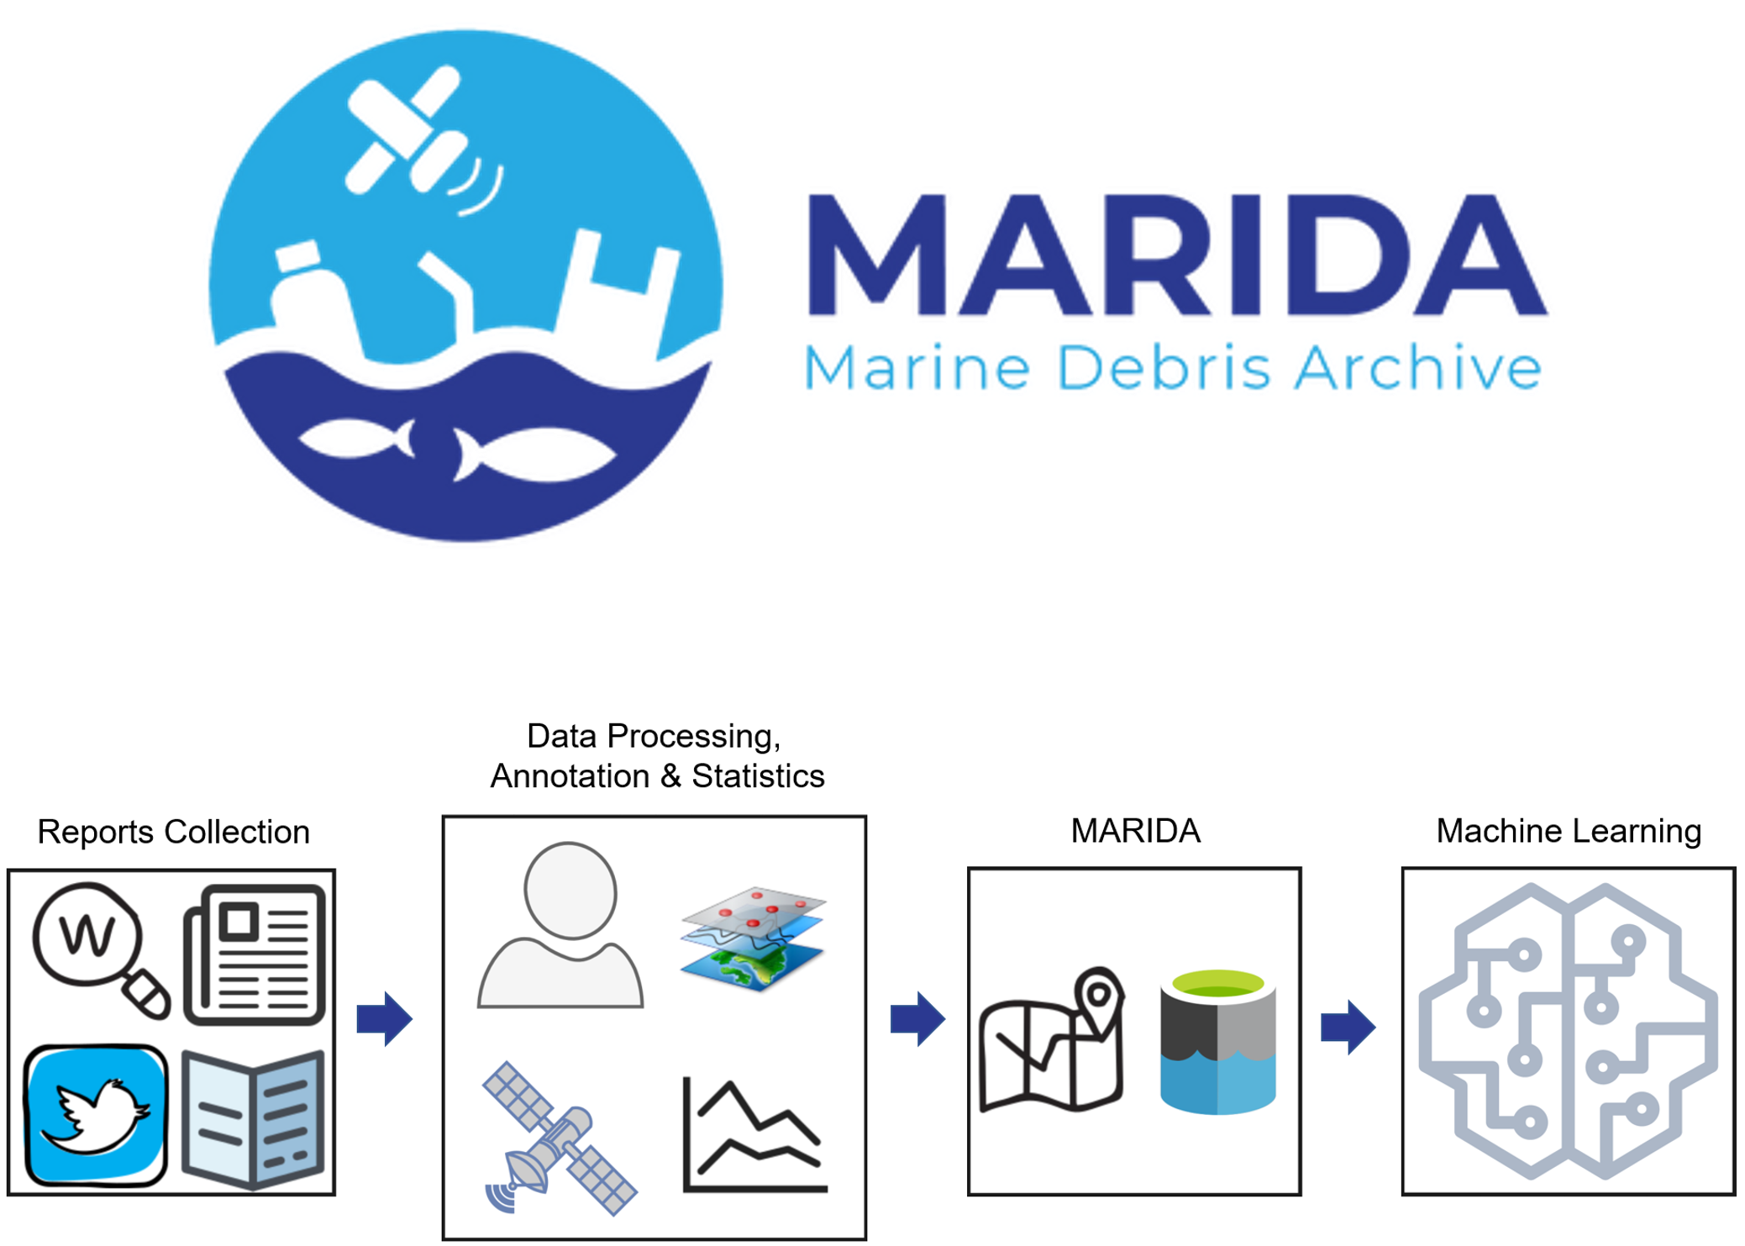
The dataset
Marine-debris oriented dataset
Based on Sentinel-2 images
Pixel-level classification
15 classes
3 levels of Confidence

Slide 6
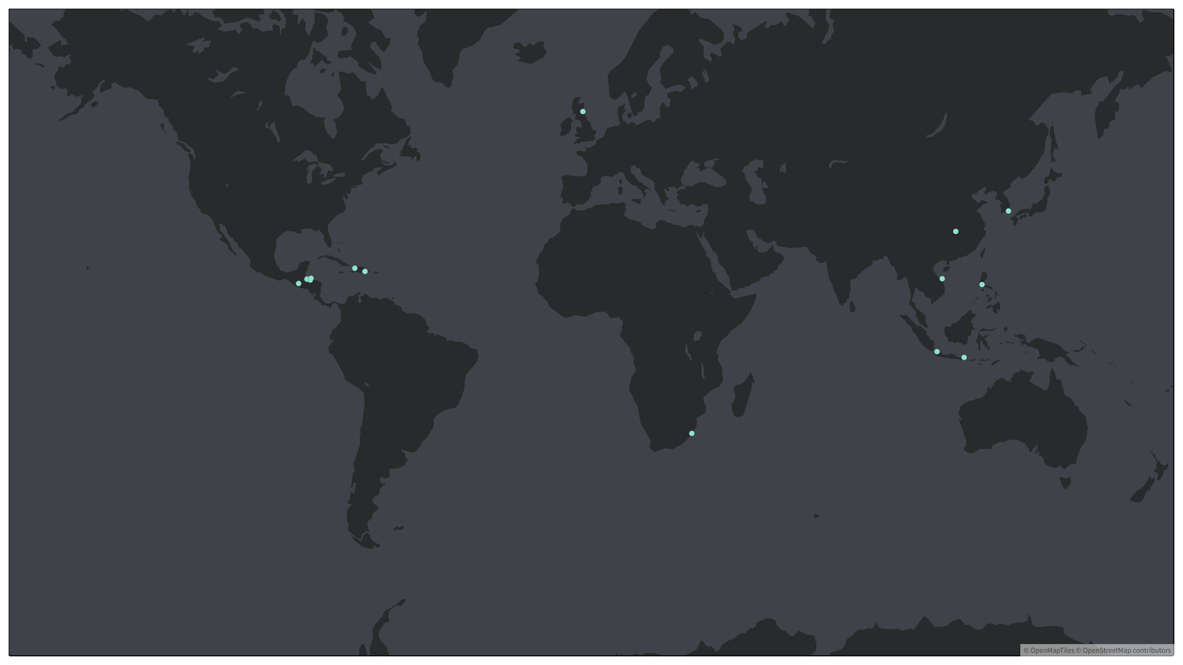
Isle of May, Scotland
Nakdong River, South Korea
Roatan, Honduras
Yangtze River, China
Ulua, Honduras
La Gonave, Haiti
Da Nang, Vietnam
Ozama River, Santo Domingo
Manila, Philippines
La Ceiba, Honduras
Motagua River, Guatemala
Bali, Indonesia
Jakarta, Indonesia
Durban, South Africa

Slide 7
Class
Confidence
Sediment-Laden Water
Turbid Water
Marine Water
Clouds
Shallow Water
Cloud Shadows
Wakes
Waves
Ship
Marine Debris
Dense Sargassum
Sparse Sargassum
Foam
Natural Organic Material
Mixed Water

Slide 8

How to retrieve satellite data?
Collection of Python packages developed to access sitellite imagery
Bridge between Earth observation field and Python ecosystem
Modular
Easy to use

Slide 9
EOPatch
EOTask
EOWorkflow
The standard data container
Stores all data for a single geographical location and for a time range
Operation on one or more EOPatches
Can access existing data, add, delete or modify features
The pipeline composed by a collection of EOTasks
Sequence of actions to be performed by the EOExecutor

Slide 10
The workflow
Sentinel Bands
Request for Sentinel-2 bands download
MARIDA Class
and Confidence
Import MARIDA Class and Confidence data into the EOPatch
NDVI, NDWI,
NDMI, FAI, FDI
Compute Normalized Difference Vegetation Index, Normalized Difference Water Index,
Normalized Difference Moisture Index, Floating Algae Index, Floating Debris Index
Save
Save the EOPatch to the desired folder

Slide 11
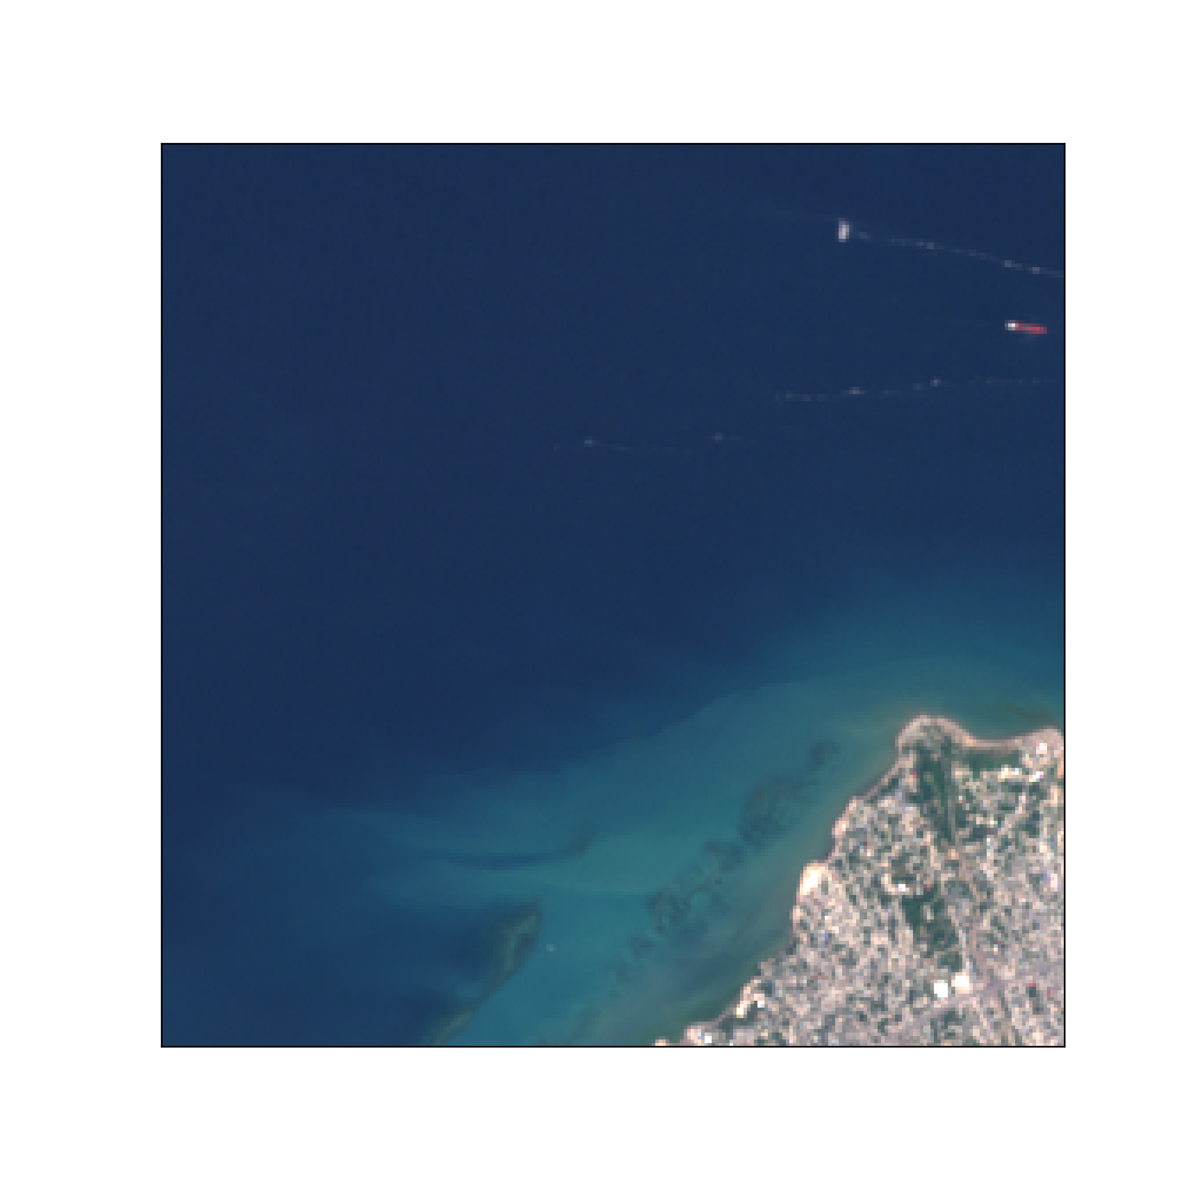
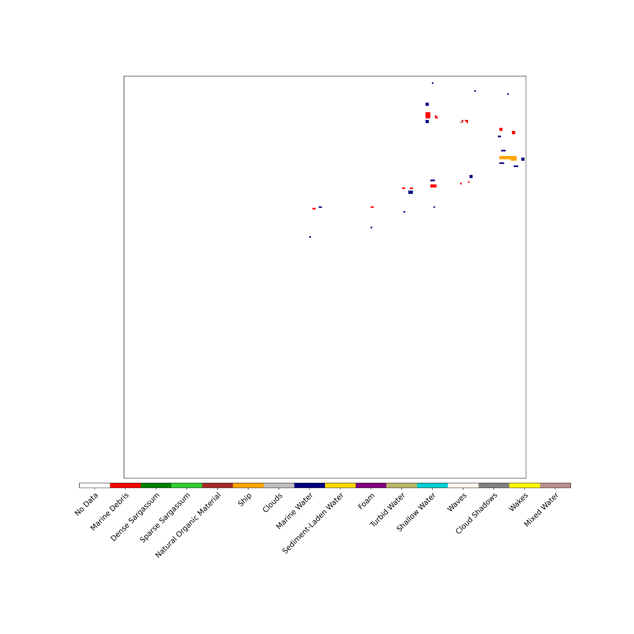
RGB image
Labels

Slide 12
Let’s build the classifier
GridSearchCV
Results
Random Forest 0.94
Decision Tree 0.86
HistGradientBoosting 0.85
AdaBoost 0.27
Stratified train test split, 70-30
StratifiedKFold
Confidence as sample_weight
f1_macro score
Search among Decision Tree, Random Forest, AdaBoost and HistGradientBoosting

Slide 13
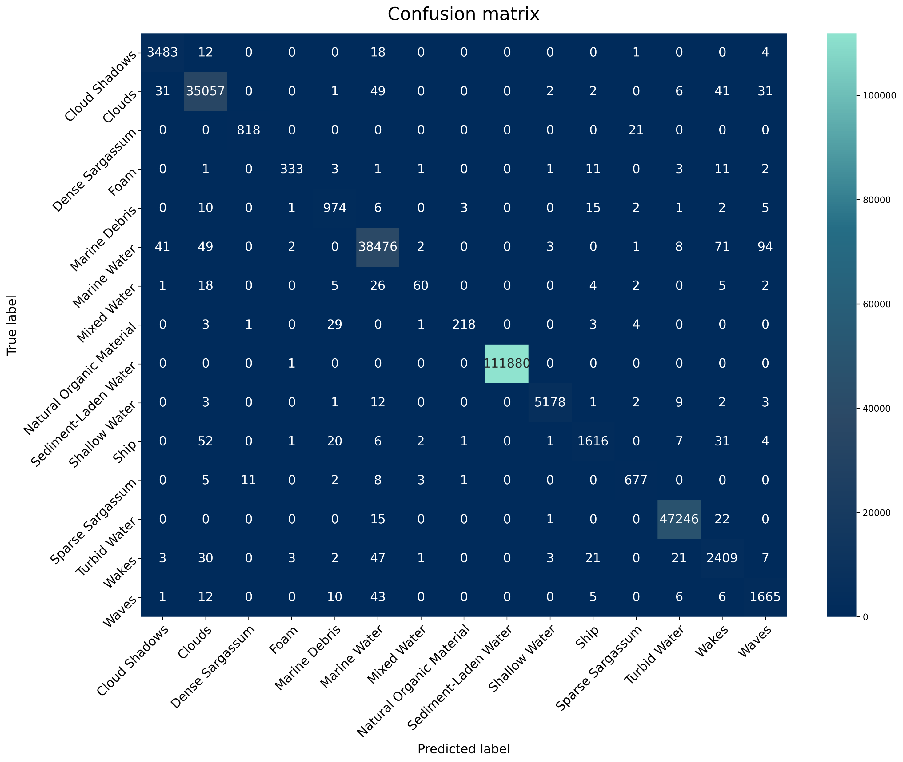
Best model
Random Forest
Estimators = 125
Max_depth = 22
Class weight inversely proportional to class frequencies
Confidence as sample weight
Scores
Training time < 2 min
Test time < 2 sec
precision_macro on test set 0.96
recall_macro on test set 0.93
f1_macro on test set 0.94
No further improvements with PCA, RFE

Slide 14
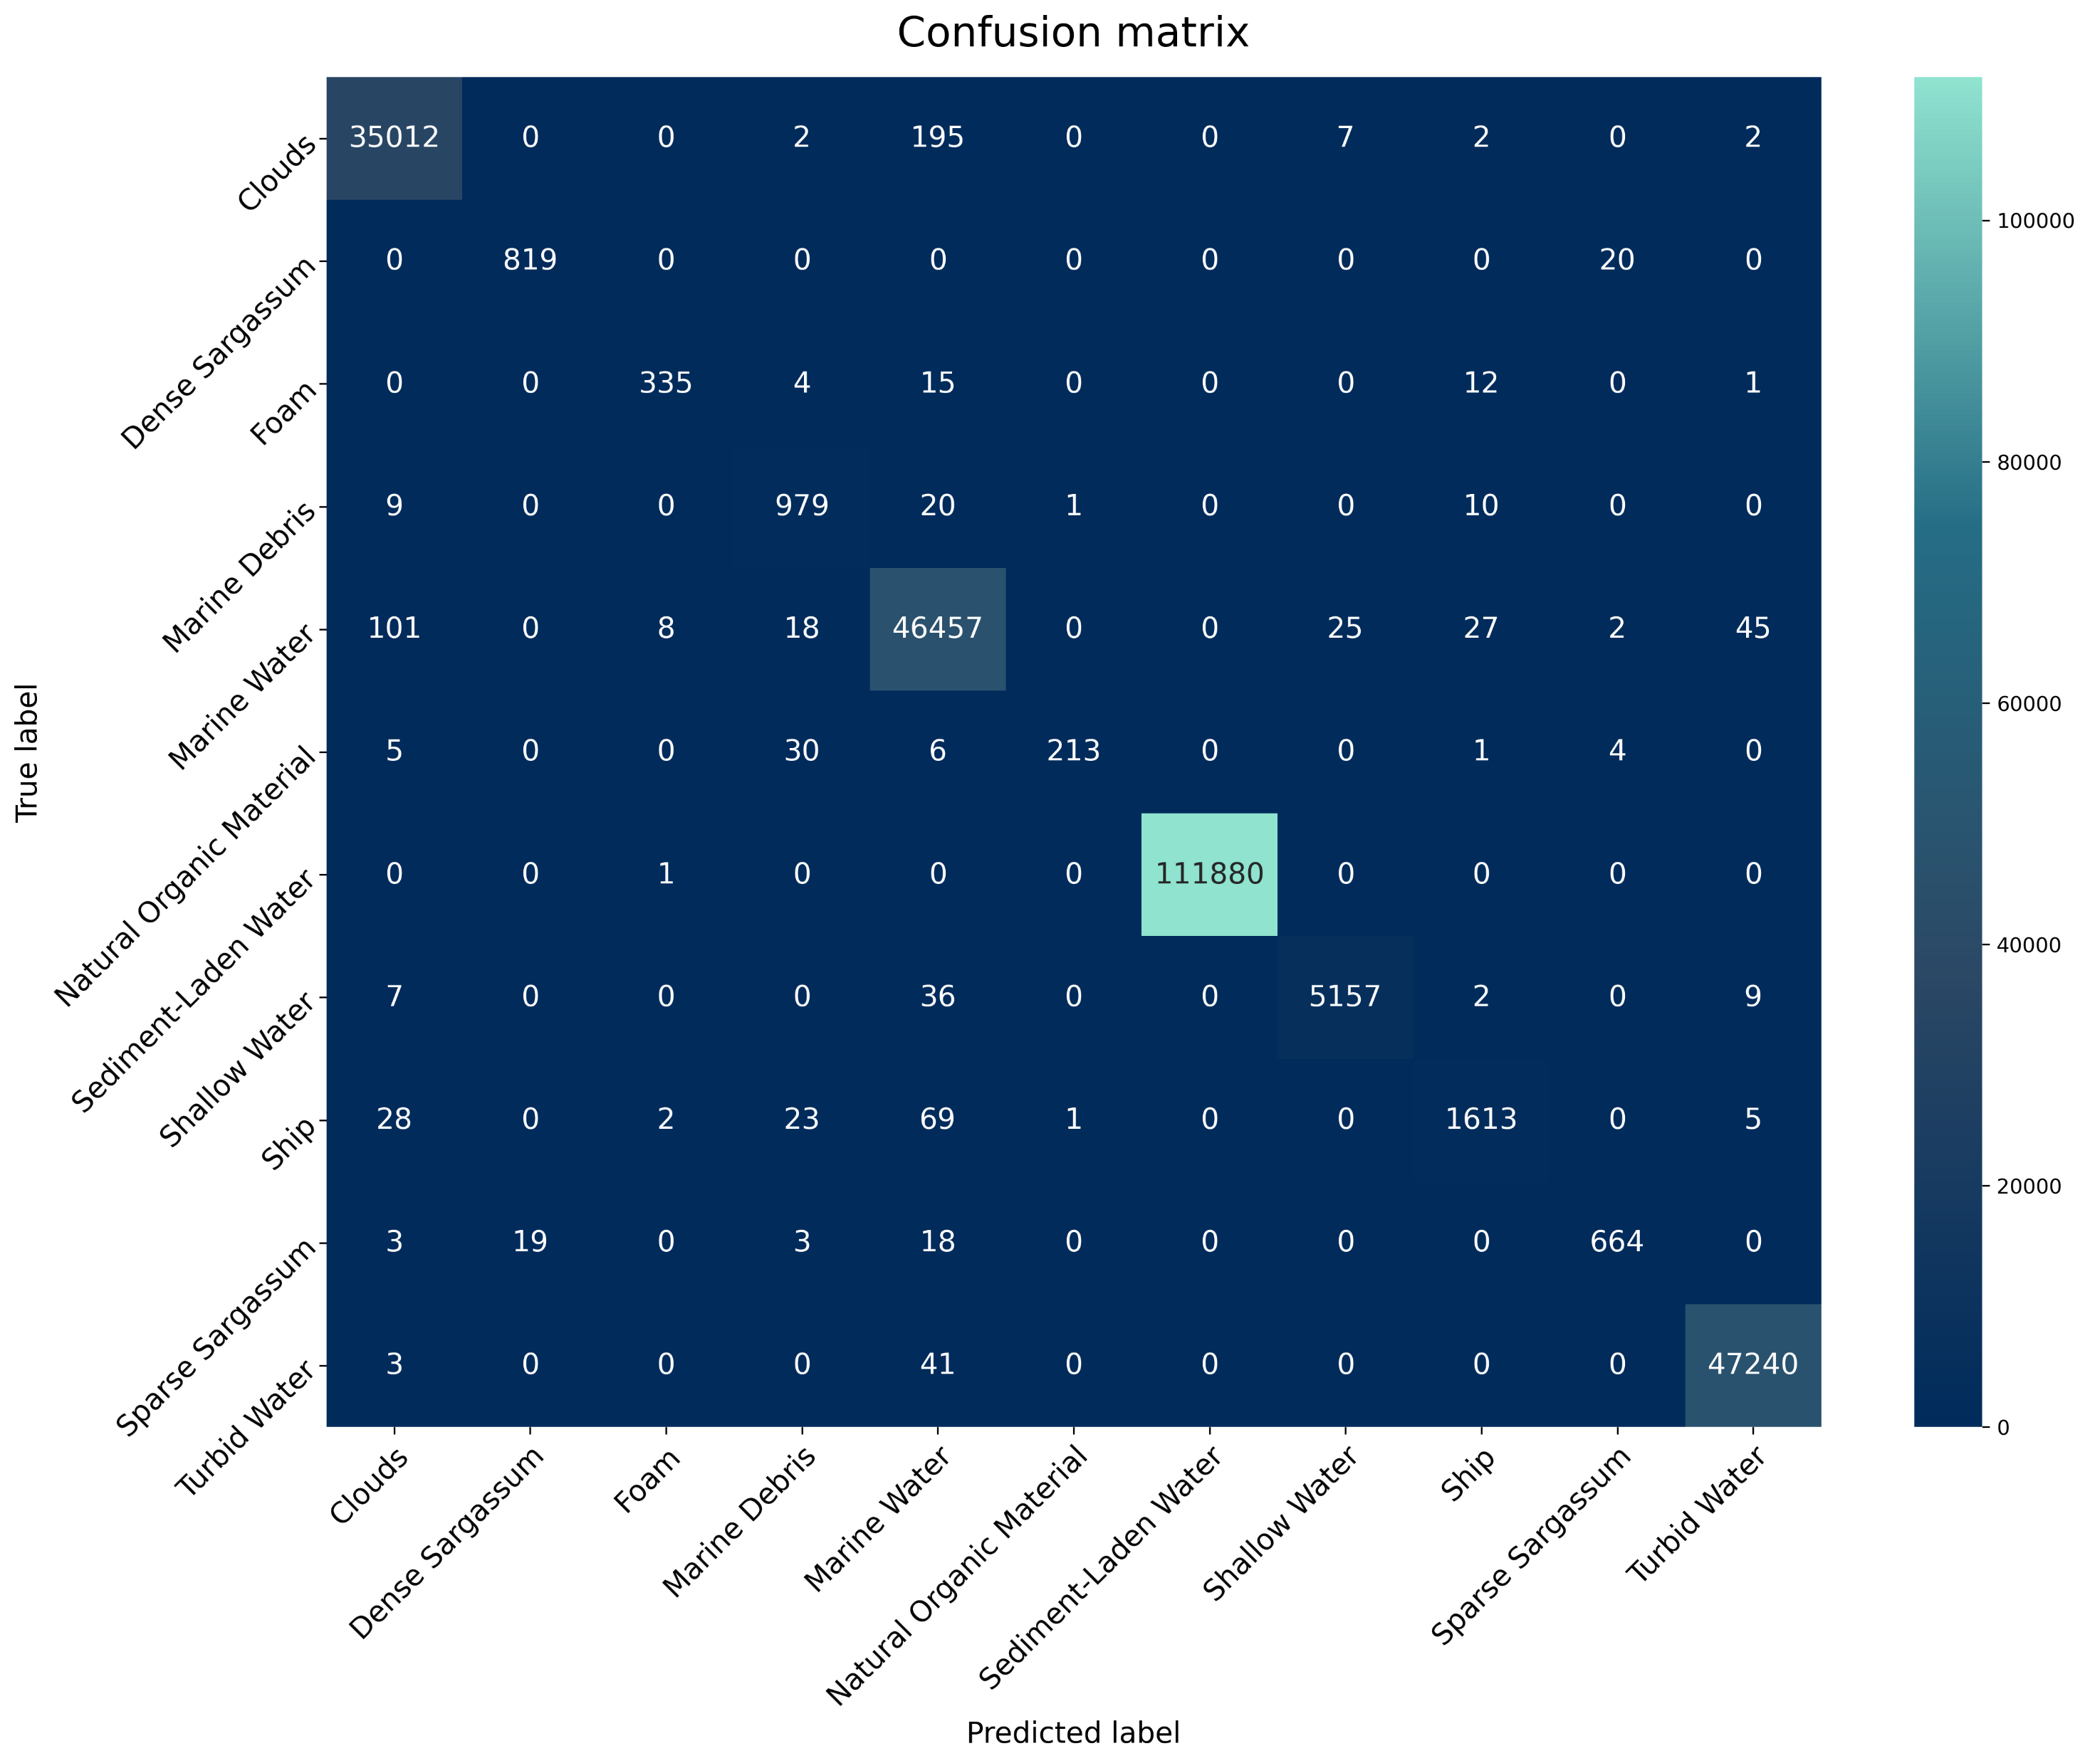
Water Superclass
Random Forest
Mixed Water
Wakes
Cloud Shadows
Waves
Marine Water
Same parameters as before
Scores
Training time < 2 min
Test time < 2 sec
precision_macro on test set 0.98
recall_macro on test set 0.96
f1_macro on test set 0.97

Slide 15
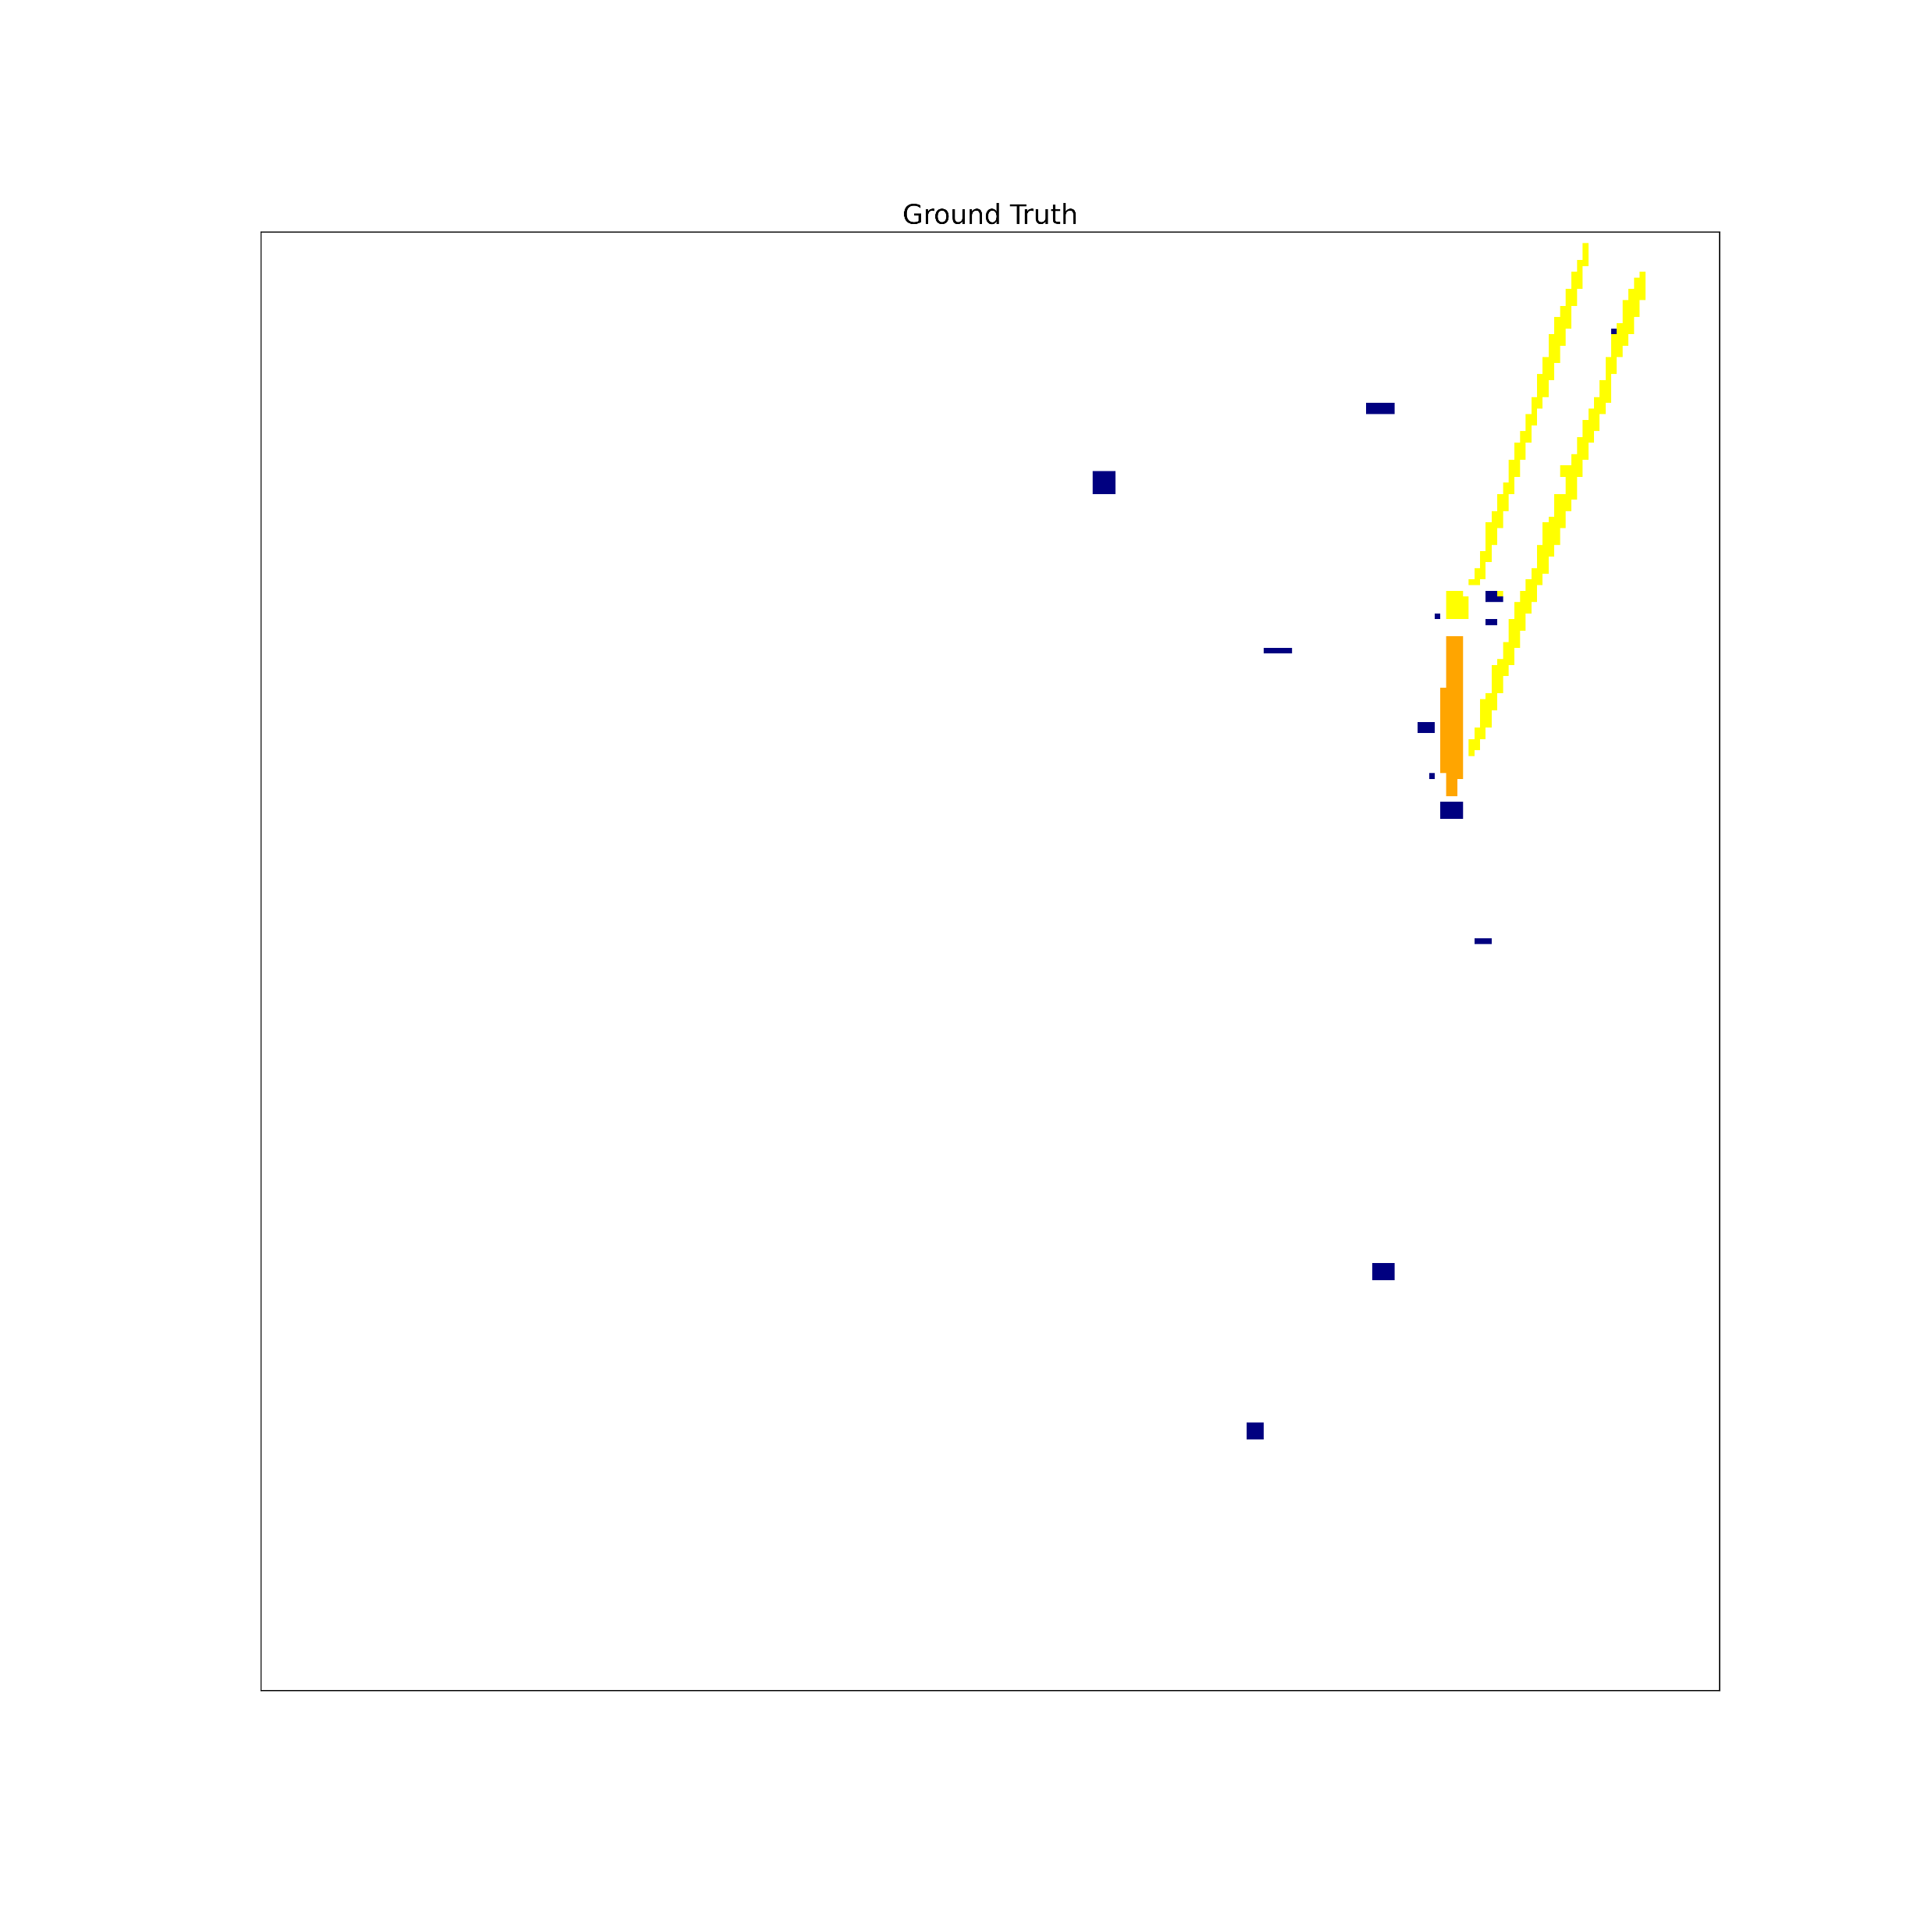
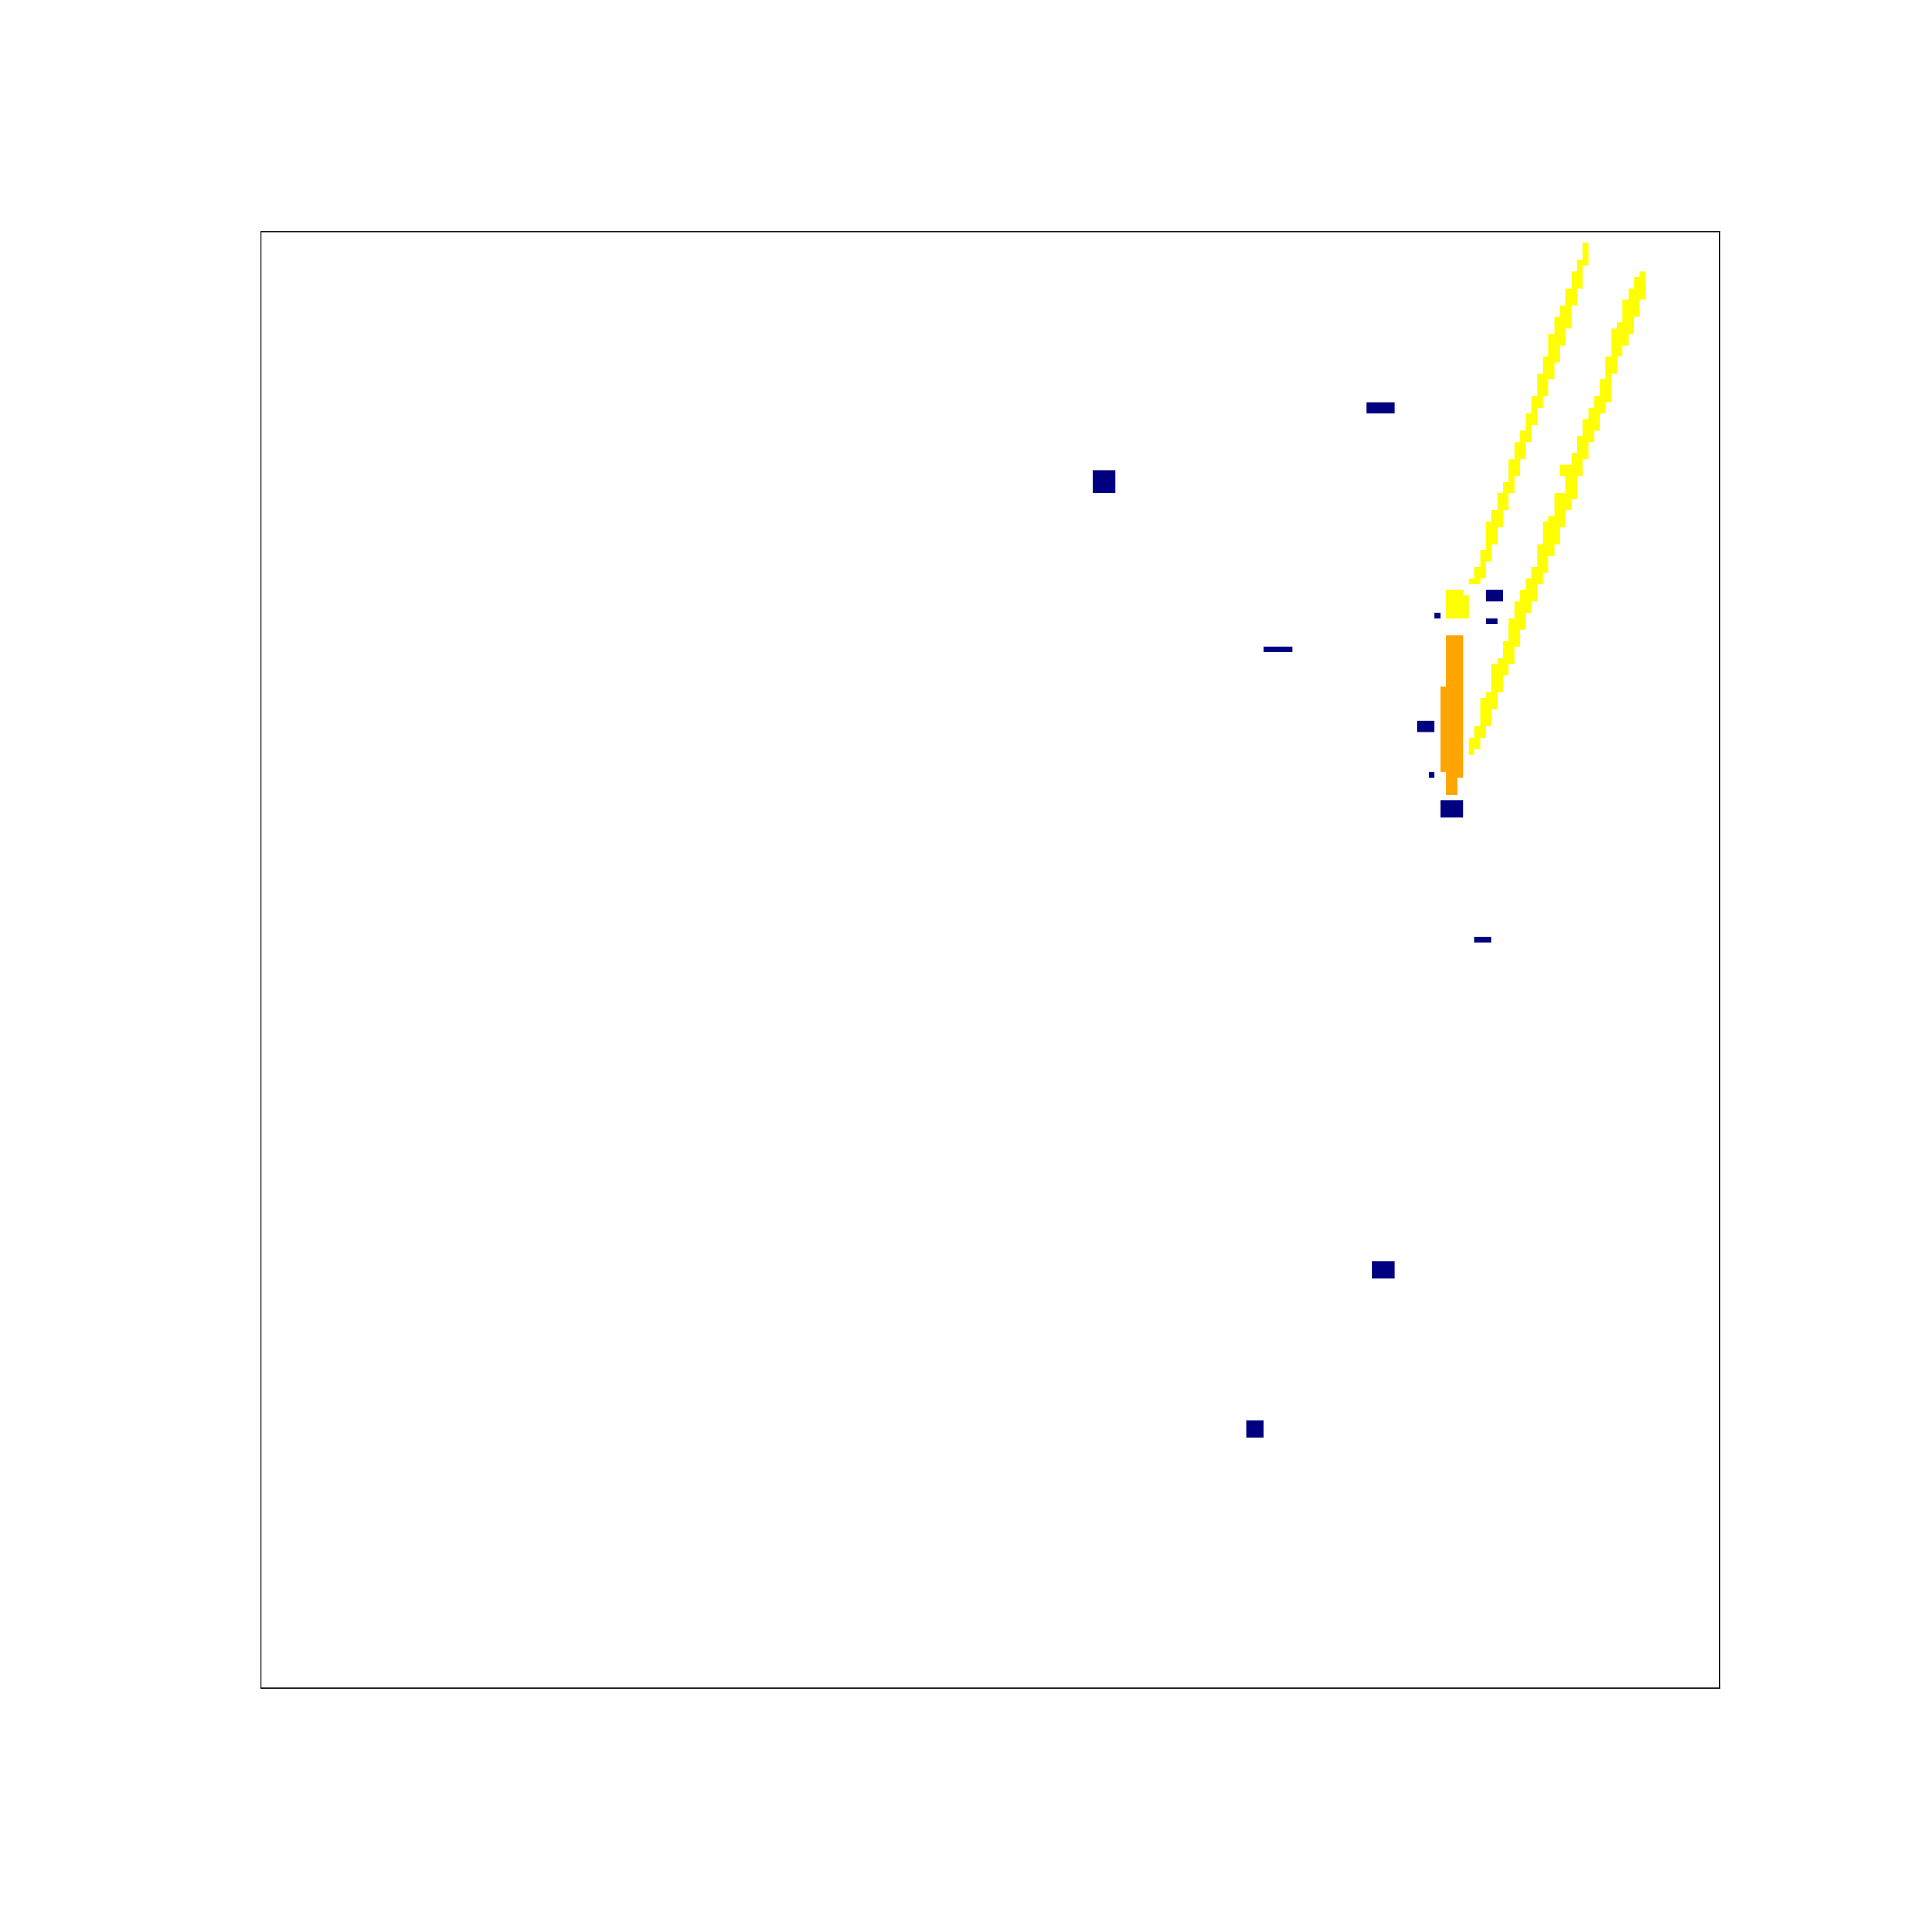
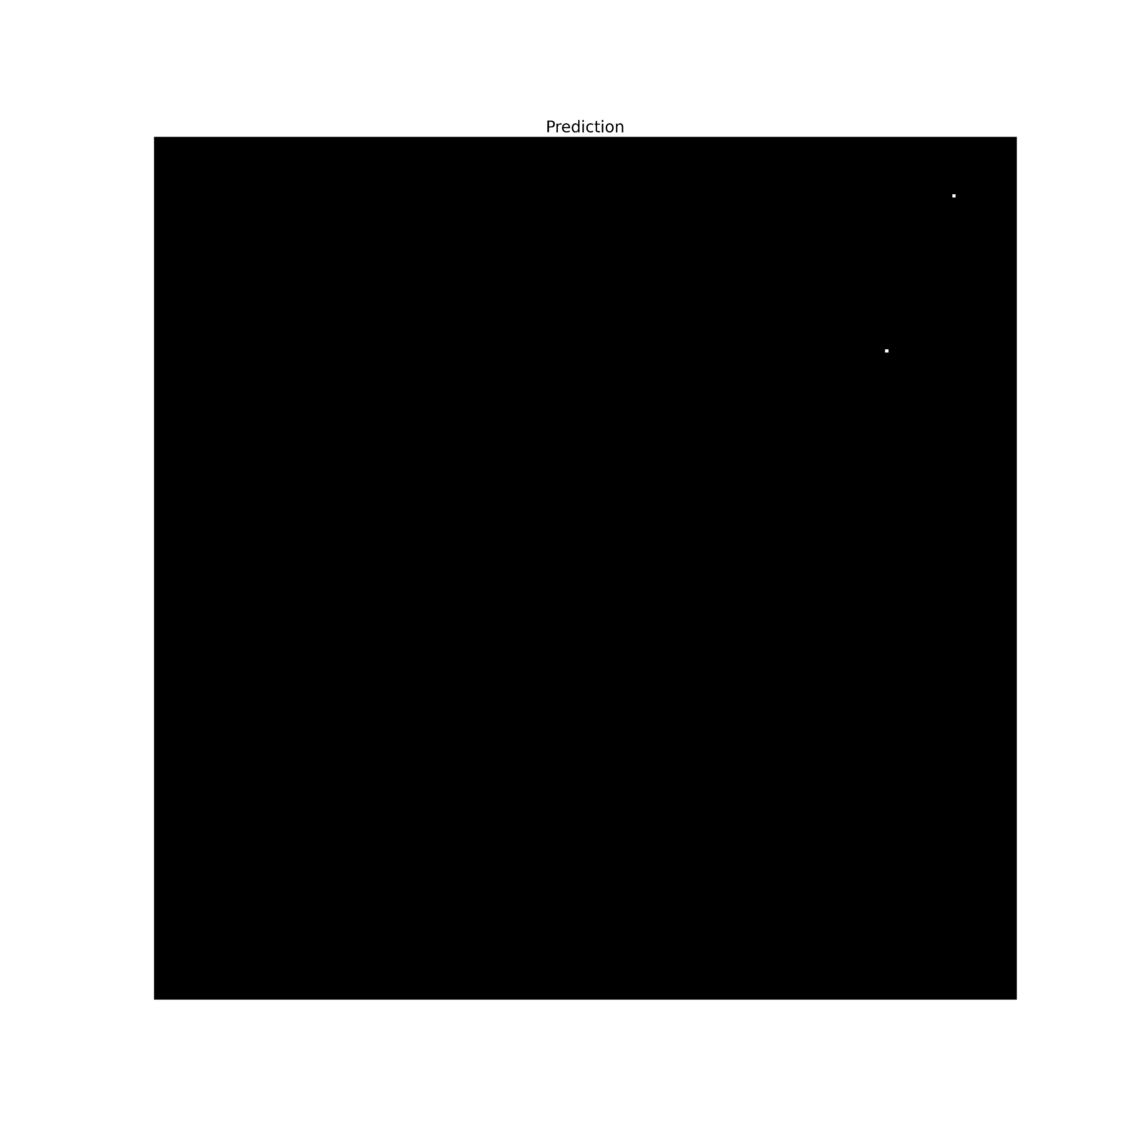
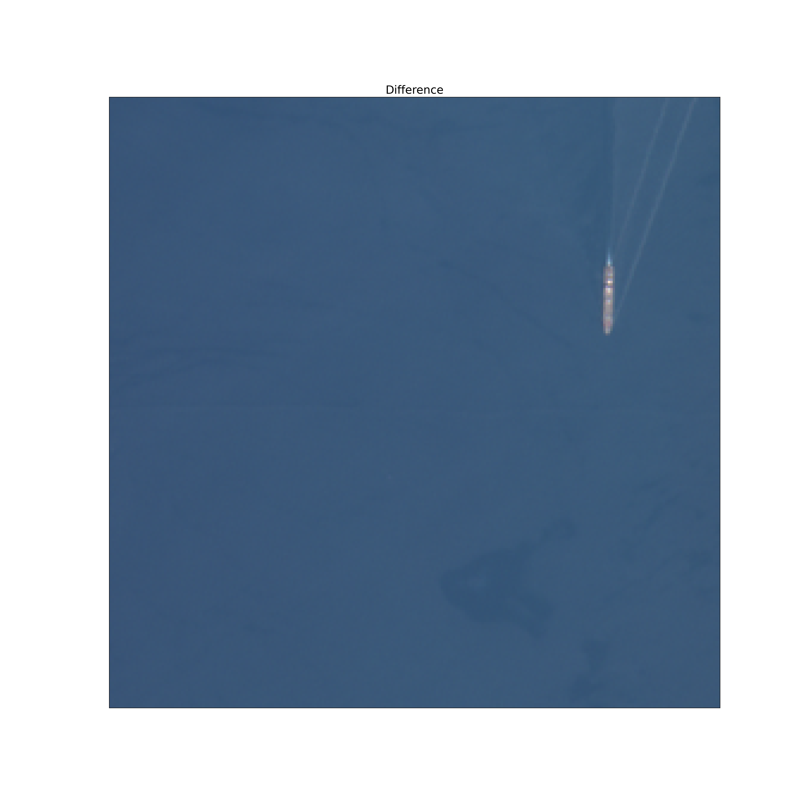
Prediction example
Prediction
Ground Truth
Difference
True Color

Slide 16
References
Copernicus
Copernicus
https://www.copernicus.eu/en/about-copernicus
MARIDA
MARIDA
https://github.com/marine-debris/marine-debris.github.io
https://journals.plos.org/plosone/article?id=10.1371/journal.pone.0262247
Eo-learn
https://eo-learn.readthedocs.io/en/latest/

